Slide 1

AWS (AMAZON WEBSERVICES)
Submitted By:-
ANJALI KUMARI
Roll no:-15110140
C.S.E.(2K15) 4 MONTHS HARDWARE TRAINING

Slide 2
Overview
AWS
Types of site : Subsidiary
Key people : Andy Jassy (CEO)
Industry : Web services, cloud computing
Subsidiaries Annapurna Labs AWS Elemental
Website aws.amazon,com
Launched March 2006: 12 years ago

Slide 3
AMAZON ELASTIC LOAD BALANCING
Elastic Load Balancing distributes incoming application or network traffic across multiple targets, such as Amazon EC2 instances, containers, and IP addresses, in multiple Availability Zones. Elastic Load Balancing scales your load balancer as traffic to your application changes over time, and can scale to the vast majority of workloads automatically.
Load Balancer Benefits
A load balancer distributes workloads across multiple compute resources, such as virtual servers. Using a load balancer increases the availability and fault tolerance of your applications.
You can add and remove compute resources from your load balancer as your needs change, without disrupting the overall flow of requests to your applications

Slide 4
Create a Classic Load Balancer
This tutorial provides a hands-on introduction to Classic Load Balancers through the AWS Management Console, a web-based interface. You'll create a load balancer that receives public HTTP traffic and sends it to your EC2 instances.
Note that you can create your load balancer for use with EC2-Classic or a VPC. Some of the tasks described in this tutorial apply only to load balancers in a VPC.
Tasks
Before You Begin
Step 1: Select a Load Balancer Type
Step 2: Define Your Load Balancer
Step 3: Assign Security Groups to Your Load Balancer in a VPC
Step 4: Configure Health Checks for Your EC2 Instances
Step 5: Register EC2 Instances with Your Load Balancer
Step 6: Tag Your Load Balancer (Optional)
Step 7: Create and Verify Your Load Balancer
Step 8: Delete Your Load Balancer (Optional)

Slide 5
Before You Begin
Complete the steps in Prepare Your VPC and EC2 Instances.
Launch the EC2 instances that you plan to register with your load balancer. Ensure that the security groups for these instances allow HTTP access on port 80.
Install a web server, such as Apache or Internet Information Services (IIS), on each instance, enter its DNS name into the address field of an Internet-connected web browser, and verify that the browser displays the default page of the server.

Slide 6
Step 1: Select a Load Balancer Type
Elastic Load Balancing supports three types of load balancers: Application Load Balancers, Network Load Balancers, and Classic Load Balancers. For this tutorial, you create a Classic Load Balancer. Alternatively, to create an Application Load Balancer, see Getting Started with Application Load Balancers in the User Guide for Application Load Balancers.
To create a Classic Load Balancer
Open the Amazon EC2 console at https://console.aws.amazon.com/ec2/.
On the navigation bar, choose a region for your load balancer. Be sure to select the same region that you selected for your EC2 instances.
On the navigation pane, under LOAD BALANCING, choose Load Balancers.
Choose Create Load Balancer.
For Classic Load Balancer, choose Create

Slide 7
Step 2: Define Your Load Balancer
You must provide a basic configuration for your load balancer, such as a name, a network, and a listener.
A listener is a process that checks for connection requests. It is configured with a protocol and a port for front-end (client to load balancer) connections and a protocol and a port for back-end (load balancer to instance) connections. In this tutorial, you configure a listener that accepts HTTP requests on port 80 and sends them to your instances on port 80 using HTTP.

Slide 8
To define your load balancer and listener
For Load Balancer name, type a name for your load balancer.
The name of your Classic Load Balancer must be unique within your set of Classic Load Balancers for the region, can have a maximum of 32 characters, can contain only alphanumeric characters and hyphens, and must not begin or end with a hyphen.
For Create LB inside, select the same network that you selected for your instances: EC2-Classic or a specific VPC.
[Default VPC] If you selected a default VPC and would like to choose the subnets for your load balancer, select Enable advanced VPC configuration.
Leave the default listener configuration.

Slide 9
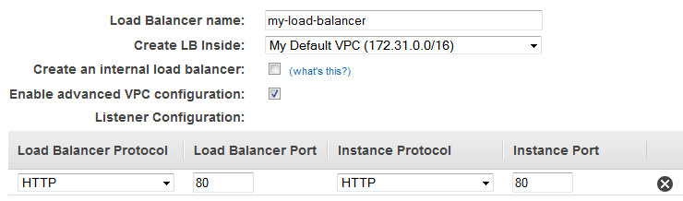
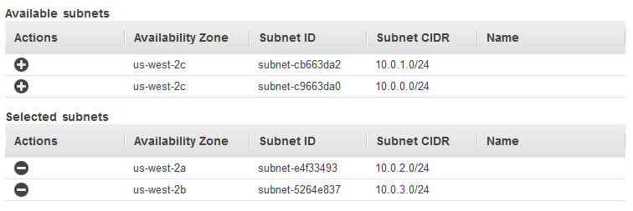
[EC2-VPC] For Available subnets, select at least one available public subnet using its add icon. The subnet is moved under Selected subnets. To improve the availability of your load balancer, select more than one public subnet.
Choose Next: Assign Security Groups.

Slide 10
Step 3: Assign Security Groups to Your Load Balancer in a VPC
If you selected a VPC as your network, you must assign your load balancer a security group that allows inbound traffic to the ports that you specified for your load balancer and the health checks for your load balancer.
Note
If you selected EC2-Classic as your network, you can continue to the next step. By default, Elastic Load Balancing provides a security group for load balancers in EC2-Classic.

Slide 11
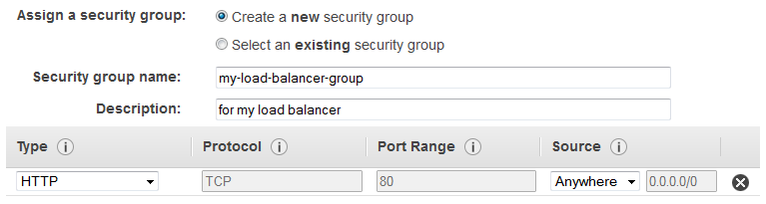
To assign security group to your load balancer
On the Assign Security Groups page, select Create a new security group.
Type a name and description for your security group, or leave the default name and description. This new security group contains a rule that allows traffic to the port that you configured your load balancer to use.
Choose Next: Configure Security Settings.
For this tutorial, you are not using a secure listener. Choose Next: Configure Health Check to continue to the next step.

Slide 12
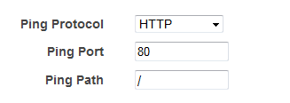
For Advanced Details, leave the default values.
Choose Next: Add EC2 Instances.
Step 5: Register EC2 Instances with Your Load Balancer
Your load balancer distributes traffic between the instances that are registered to it.
Note
When you register an instance with an elastic network interface (ENI) attached, the load balancer routes traffic to the primary IP address of the primary interface (eth0) of the instance.

Slide 13
To register EC2 instances with your load balancer
On the Add EC2 Instances page, select the instances to register with your load balancer.
Leave cross-zone load balancing and connection draining enabled.
Choose Next: Add Tags.
Alternatively, you can register instances with your load balancer later on using the following options:
Select running instances after you create the load balancer. For more information, see Register Instances with Your Load Balancer.
Set up Auto Scaling to register the instances automatically when it launches them. For more information, see Set Up a Scaled and Load-Balanced Application in the Amazon EC2 Auto Scaling User Guide.

Slide 14
Step 6: Tag Your Load Balancer (Optional)
You can tag your load balancer, or continue to the next step. Note that you can tag your load balancer later on; for more information, see Tag Your Classic Load Balancer.
To add tags to your load balancer
On the Add Tags page, specify a key and a value for the tag.
To add another tag, choose Create Tag and specify a key and a value for the tag.
After you are finished adding tags, choose Review and Create.

Slide 15
Step 7: Create and Verify Your Load Balancer
Before you create the load balancer, review the settings that you selected. After creating the load balancer, you can verify that it's sending traffic to your EC2 instances.
To create and test your load balancer
On the Review page, choose Create.
After you are notified that your load balancer was created, choose Close.
Select your new load balancer.
On the Description tab, check the Status row. If it indicates that some of your instances are not in service, its probably because they are still in the registration process. For more information, see Troubleshoot a Classic Load Balancer: Instance Registration

Slide 16
After at least one of your EC2 instances is in service, you can test your load balancer. Copy the string from DNS name (for example, my-load-balancer-1234567890.us-west-2.elb.amazonaws.com) and paste it into the address field of an Internet-connected web browser. If your load balancer is working, you see the default page of your server.
Step 8: Delete Your Load Balancer (Optional)
As soon as your load balancer becomes available, you are billed for each hour or partial hour that you keep it running. When you no longer need a load balancer, you can delete it. As soon as the load balancer is deleted, you stop incurring charges for it. Note that deleting a load balancer does not affect the instances registered with the load balancer

Slide 17
To delete your load balancer
If you have a CNAME record for your domain that points to your load balancer, point it to a new location and wait for the DNS change to take effect before deleting your load balancer.
Open the Amazon EC2 console at https://console.aws.amazon.com/ec2/.
On the navigation pane, under LOAD BALANCING, choose Load Balancers.
Select the load balancer.
Choose Actions, Delete.
When prompted for confirmation, choose Yes, Delete.
(Optional) After you delete a load balancer, the EC2 instances associated with the load balancer continue to run, and you are billed for each hour or partial hour that you keep them running. For information about stopping or terminating your instances, see Stop and Start Your Instance or Terminate Your Instance in the Amazon EC2 User Guide for Linux Instances.

Slide 18
Thanks

